Slide 1

Update FP 2020 – Performance Monitoring & Accountability WG
Roy Tjiong,
dipresentasikan pada Coordination Meeting FP 2020 Indonesia,
3 September 2013

Slide 2
Task of PMA Working Group
enable the data collection and analysis necessary to bolster accountability for implementing financial, policy and programming commitments

Slide 3
Focusing on measurement globally and nationally enables the world to track progress, be accountable, and problem to solve to improve performance
Inform country planning &
priorities
Provide timely feedback
about interventions to enable
course correction
Provide more frequent &
more efficient progress
estimate
Measures indicators
Disaggregate data
Track
progress
Be
accountable
Problem
Solving
to improve
performance
provide country dash board
track commitments annually

Slide 4
Performance Monitoring & Accountability Working Group
is co-led by Dr. Zeba Sathar from the Population Council in Pakistan and Dr. Marleen Temmerman from the World Health Organization
is managed on the FP2020 Task Team by Jessica Dorney Schwartzman.

Slide 5
Member of PMA Working Group
Dr. Ian Askew, Population Council
Ann Biddlecom, United Nations Population Division
Dr. Win Brown, The Bill & Melinda Gates Foundation
Julia Bunting, International Planned Parenthood Federation
Abhijit Das, Centre for Health and Social Justice
Dr. Luis Andres de Francisco Serpa, Partnership for Maternal, Newborn and Child Health

Slide 6
Member of PMA Working Group
Nel Druce, UK Department for International Development
Desmond Koroma, United Nations Population Fund
Dr. Cheikh Mbacke, William and Flora Hewlett Foundation
Dr. Scott Radloff, The Bill & Melinda Gates Institute for Population and Reproductive Health, Bloomberg School of Public Health
Dr. Sara Seims, London School of Economics; Packard Foundation

Slide 7
Member of PMA Working Group
Navendu Shekhar, Pathfinder International
Duduzile Simelane, International HIV/AIDS Alliance
Dr. Roy Tjiong, Indonesian Planned Parenthood Association
Michelle Weinberg, Marie Stopes International
Dr. Eliya Zulu, African Institute for Development Policy

Slide 8
Sub-working group PMA
PMA WG Role in Accountability | Data Utilization (promoting a culture of data-based decision-making) | Indicators & Data Sources | Developing a Learning Agenda
Mr. Abhijit Das (POC) | Dr. Cheikh Mbacke (POC) | Dr. Win Brown (POC) | Dr. Sarah Harbison (POC)
Dr. Andres de Francisco (POC) | Dr. Scott Radloff (POC) | Ms. Michelle Weinberger (POC) | Dr. Sara Seims (POC)
Ms. Nel Druce (POC) | Dr. Eliya Zulu (POC) | Ms. Ann Biddlecom | Dr. Win Brown
Mr. Abhijit Das | Dr. Andres de Francisco | Dr. Andres de Francisco | Mr. Abhijit Das
Mr. Thomas Dubois | Dr. Zeba Sathar | Mr. Navendu Shekhar | Dr. Andres de Francisco
Mr. Desmond Koroma | Dr. Marleen Temmerman | Ms. Duduzile Simelane | Mr. Thomas Dubois
Dr. Cheikh Mbacke | Dr. Roy Tjiong | Dr. Marleen Temmerman | Mr. Navendu Shekhar
Dr. Zeba Sathar |  | Dr. Marleen Temmerman
Dr. Marleen Temmerman |  | Dr. Roy Tjiong
Dr. Eliya Zulu

Slide 9


Monitoring Progress in Family Planning
Futures Institute

Slide 10
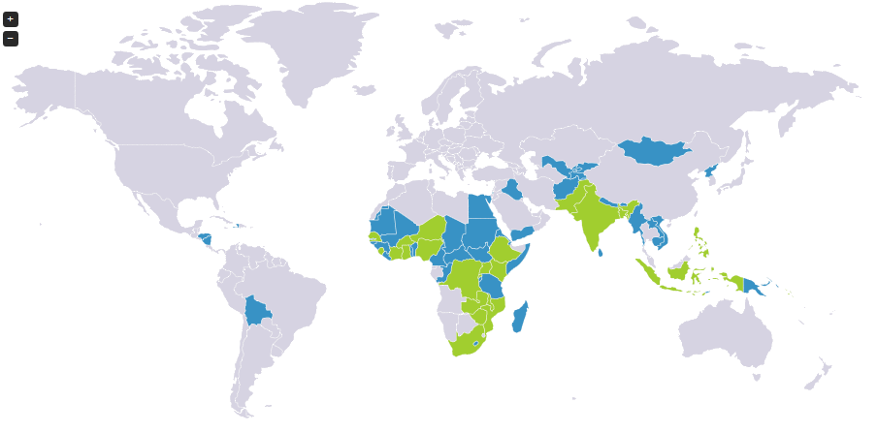

FP2020 Participating Countries
Pledging
Additional Priority Countries

Slide 11

Track Progress Toward FP2020 Objectives
Overall Strategy:
Support national efforts to collect, analyze, and use data to track progress towards the global FP2020 initiative.
Current Situation (FP)
Country Level
Use DHS data for ~5 years until
there is a new DHS
International Level
Annual estimates done by the
UN using available cross
sectional data (DHS, MICS,
RHS)
Current Situation (HIV)
Country Level & International Level
Joint analysis and issuing of annual estimates on key
indicators that use available
country produced data in addition to cross-sectional data
These estimate are different
These estimate are the same

Slide 12
Key Steps in Achieving this Change
National level M&E Officers
Expansion of UN Population Division Modeling to include additional data sources
Annual data consensus building workshops
Country expenditure tracking
Creation and implementation of FP M&E tools and materials
Documentation and dissemination of country progress and lessons learned

Slide 13
National Level M&E Officers
Offered to the 22 pledging countries (plus DRC)
Placed in the MOH, Office of Population, or other relevant body
Track20 will pay salary for the first two years, will need a sustainability plan after that
Point person for FP data, facilitate and support getting data moving through the system
Track20 will provide ongoing technical capacity building through regional trainings, country visits, and responding to technical requests
Key partners in FP monitoring field will be integrated into these trainings to learn successes in other programs and global leaders in monitoring
Provide a venue for cross-country sharing

Slide 14
Modeling with UN Pop Division
Expand current model to include FP data available in countries
Service statistics
Commodity data
Private sector
NGO service providers
Still use cross-sectional data as anchors, but will allow the additional data to contribute towards estimating the trend between surveys
Produce uncertainty bands around the estimates

Slide 15
Annual Data Consensus Building Workshops
Bring together partners (Gov, UN, USAID, NGO, etc.) to review, discuss, and analyze available data
Use expanded UN model to estimate annual mCPR
Issue annual estimates of key FP indicators
mCPR
Stock-outs
Unmet need
FP expenditures
FP info received
Number of unintended pregnancies
Number of maternal and child deaths averted
Estimates will come from a variety of sources: DHS, MICS, RHS, PMA2020, service statistics, project data, etc. and will be derived using different methodologies: direct estimates, adjusted estimates, modeling

Slide 16
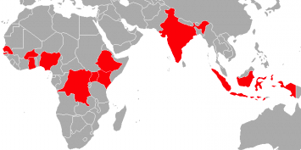
PMA 2020 Overview
10 countries planned
  Year 1: Ethiopia, DR Congo, Ghana, Kenya, Uganda
  Year 2: Burkina Faso, India (UP), Indonesia, Nigeria, Senegal
Main goal
  Monitor progress in access to and use of contraceptives;
  Track the 120M new contraceptive users to be served under FP2020;
  Build sustainable country capacity for continuous monitoring;
  Rapid data collection for
    Annual estimates
    Dissemination
2 linked mobile-assisted surveys
  Sentinel Household & Female Survey – measuring demand and use
  Service Delivery Point Survey – measuring supply and access
mADDS
mobile Assisted Data and Dissemination System

Slide 17
mADDS Features
Employs innovative mobile technology
Supports low-cost, rapid turnaround surveys
Generates annual (or semi-annual) indicators
Is expandable to other health sectors
Provides consistency with DHS measures…
…and introduces new indicators of quality, choice, access
Creates a community feedback loop to prompt program improvement
Strengthens local capacity
  Network of partner universities/research institutions
  Network of resident enumerators

Slide 18
Data Aggregation
National
extrapolation
100 sentinel sites
LEVELS OF AGGREGATION
district aggregation
All sentinel sites within a district
community-level aggregation
1 sentinel site
Households
Service Delivery Points

Slide 19
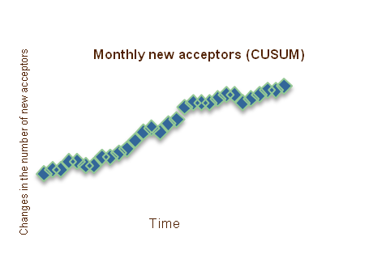

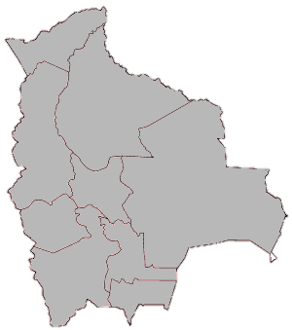
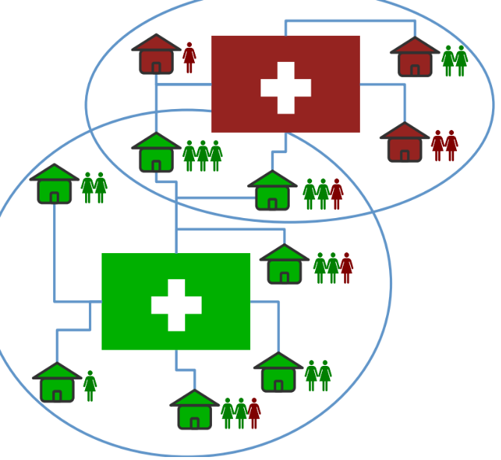

Data Analysis: informational outputs
Data collected via mobiles lends itself to new analyses that are automatically and rapidly generated. e.g. :
  Real-time CUSUM graph
  Access stock-out heat maps
  Contraceptive network maps
Upper threshold
Lower threshold
450 pill cycles in stock
700 condoms in stock
200 injectable vials in stock
150 IUDs in stock
1 country
District level (multiple sentinels)

Slide 20
Measuring access, equity, quality, choice
Female Survey (51 questions/31 on FP)
All indicators can be disaggregated by age, marital status, wealth quintile, education, region, urban/rural
For Users (…most recent visit)
  Did you obtain the method you wanted? If not, why not?
  Who made the final decision on the method you received?
  Did you pay anything for the services received? If yes, how much?
  Were you told of other methods?
  Were you told of side effects of your method? What to do if you experienced side effects?
  Would you return to this provider? Refer relative/friend to provider?
  If sterilized, were you told that this method was permanent?
For Discontinued Users
  What was your method? When did you stop using? Why did you stop using?
For Women with Unmet Need
  Reason for not using a method?

Slide 21
Measuring access, equity, quality, choice
Female Survey (51 questions/31 on FP)
All indicators can be disaggregated by age, marital status, wealth quintile, education, region, urban/rural
For Users (…most recent visit)
  Did you obtain the method you wanted? If not, why not?
  Who made the final decision on the method you received?
  Did you pay anything for the services received? If yes, how much?
  Were you told of other methods?
  Were you told of side effects of your method? What to do if you experienced side effects?
  Would you return to this provider? Refer relative/friend to provider?
  If sterilized, were you told that this method was permanent?
For Discontinued Users
  What was your method? When did you stop using? Why did you stop using?
For Women with Unmet Need
  Reason for not using a method?

Slide 22
Measuring access, equity, quality, choice
SDP Survey (56 questions/42 on FP)
Service Accessibility
  How many days a week is FP offered? Are services offered today?
  What methods are counseled? Provided? Referred? Charged?
  Have any methods been out of stock in the last 12 months? Which methods?
  If implants provided, are there trained personnel to insert? Remove? Are key supplies in place? (repeated for IUDs)
  Are unmarried adolescents counseled, offered, referred for contraceptive methods?
  Are CHWs supported from facility? If so, how many? What FP services do they offer?
  Has mobile outreach team worked from facility? How many times in last year?
  Does facility charge fees for FP services? How much by method?
Service Quality
  Does facility have system for client feedback? Ask to see. Has there been change?
  When was the last time a supervisor from outside this facility came here to visit?
Integrated services
  If delivery/maternity: Is FP counseled during the post-partum visit? Are services offered/referred? (repeated for post-abortion, HIV-related services)

Slide 23


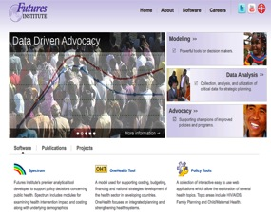
Dissemination
Automatically populate databases
  real-time in-country access
  external access upon request
Annual reports available online

Slide 24
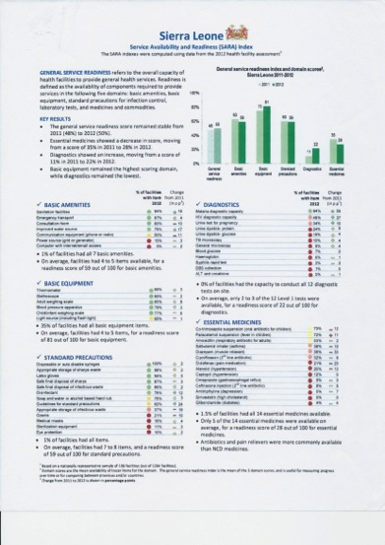

Potential dissemination format

Slide 25
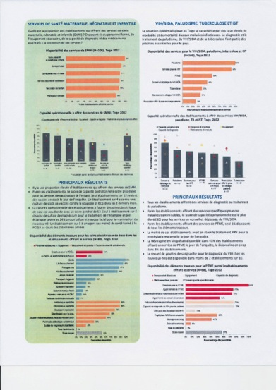

Potential dissemination format

